Slide 1
JS Overload
Visualizing Stack Overflow 2019 Survey Results Utilizing JavaScript
Group Members: Cy Edmonds, Mauricio Ramirez, Franklin Gonzales, Harish Krishna

Slide 2
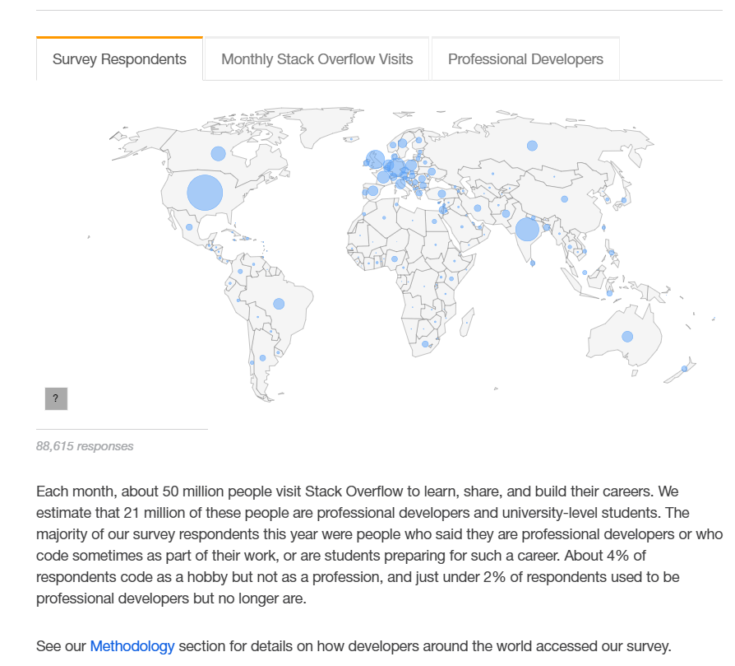
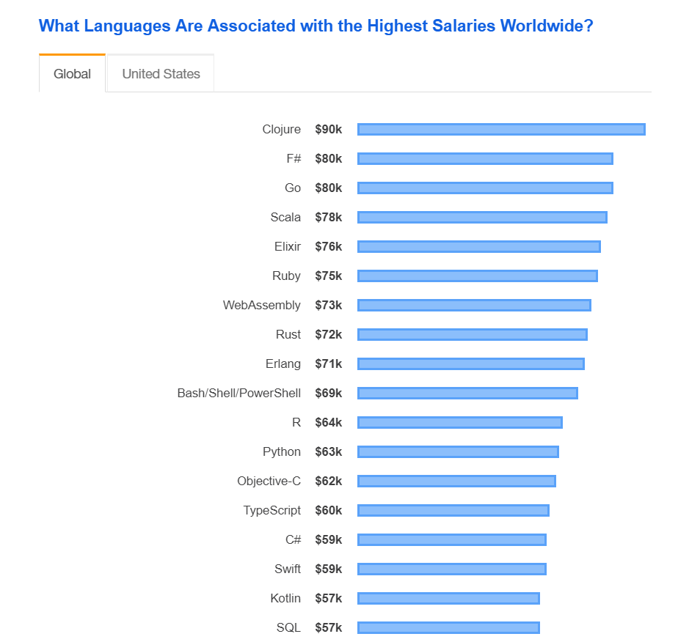
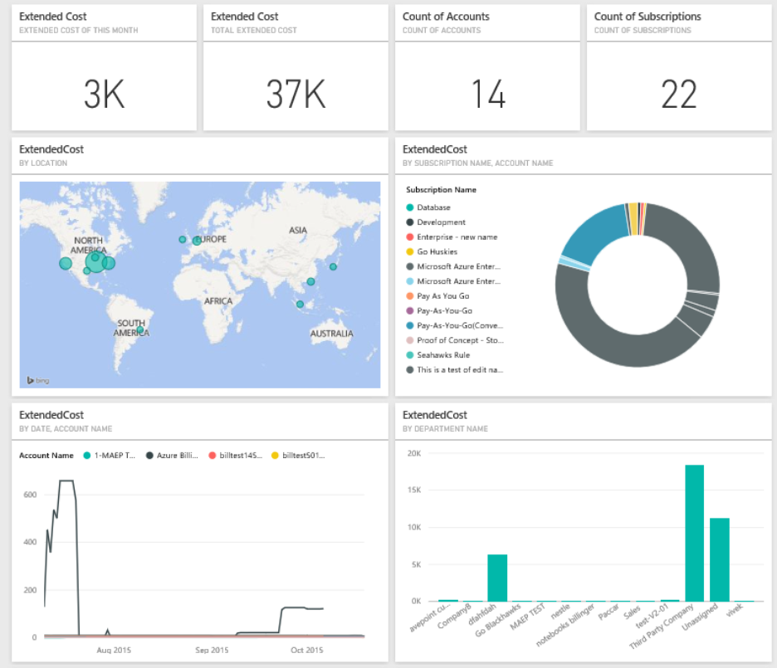
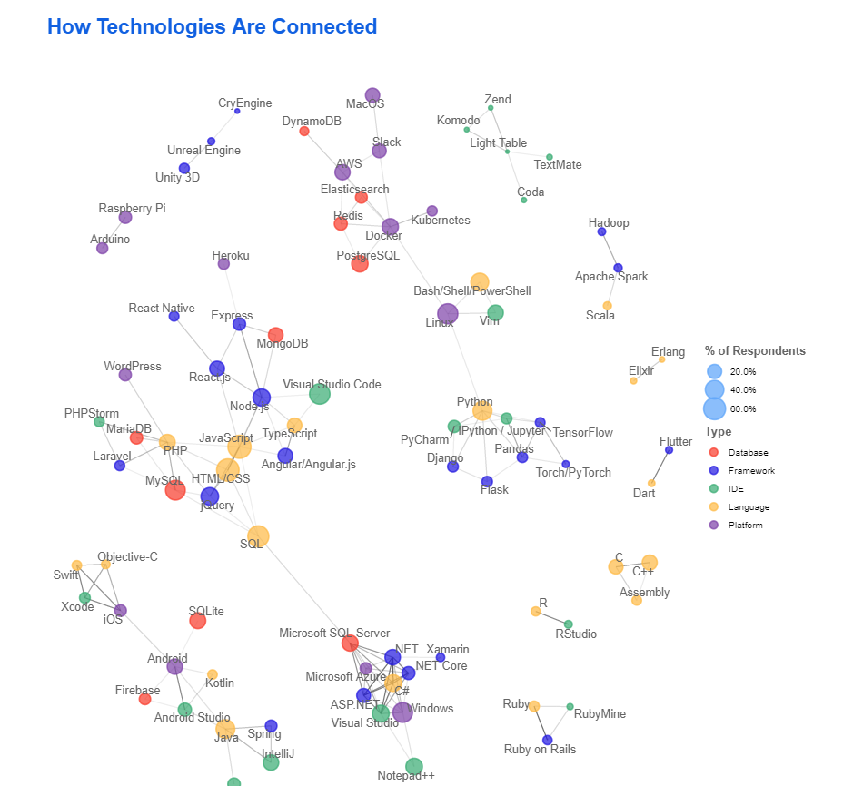
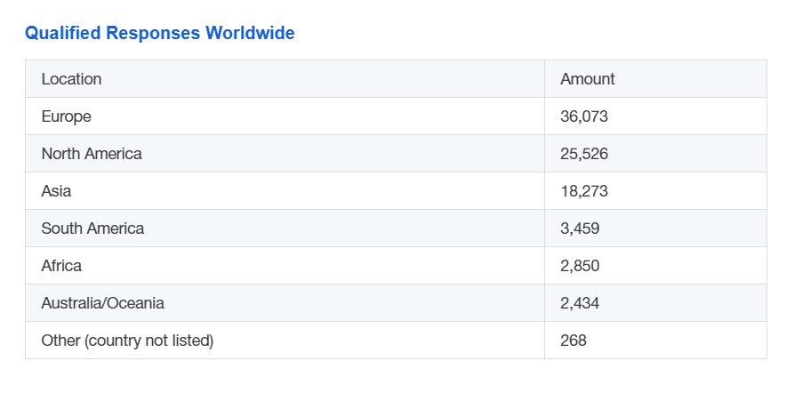
Project goals:
Stack Overflow:
https://insights.stackoverflow.com/survey/2019
Inspiration:
What we would try to produce.

Slide 3
Technologies used
Dataset: Stack Overflow 2019 Survey (survey_results_public.csv)
https://insights.stackoverflow.com/survey
SQL database hosted on Azure
Primary Coding: Python, SQL, JavaScript, HTML, CSS
Additional tools: Bokeh, amCharts4, D3, Bootstrap

Slide 4

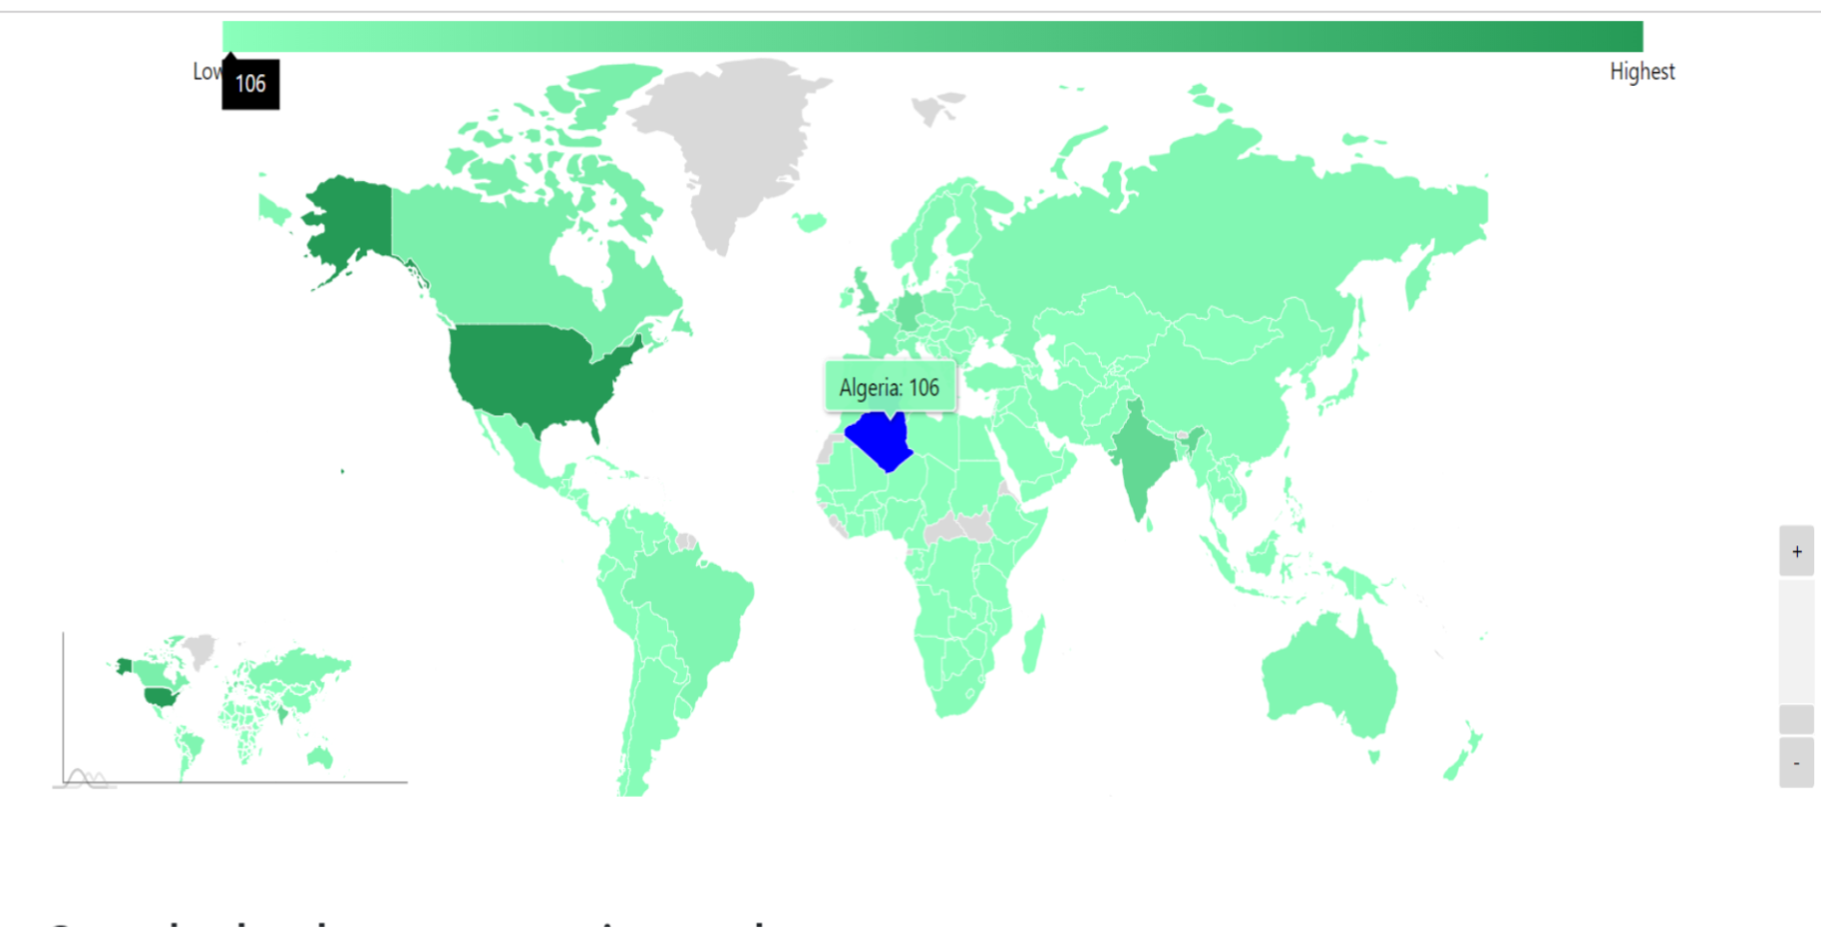

amCharts4: World Choropleth
Link to the app: https://jsoverload.azurewebsites.net/cy
Mapping total respondents per country
Highlight on mouseover
Highlighted countries display tooltip
Tooltip on legend for selection
Zoom control with slider and small map for controls

Slide 5
the story behind the map
What worked:
It loads!
Data is correlated with map.
Interactivity works as intended.
Doesn’t take too long to load!
(kinda)
What didn’t work:
The Bokeh version.
Complications from available data.
The data for individual countries skews so far on the high side that most of the map looks the same shade.
Data import needed a work around due to programmer inexperience.
BUT IT WORKS!

Slide 6
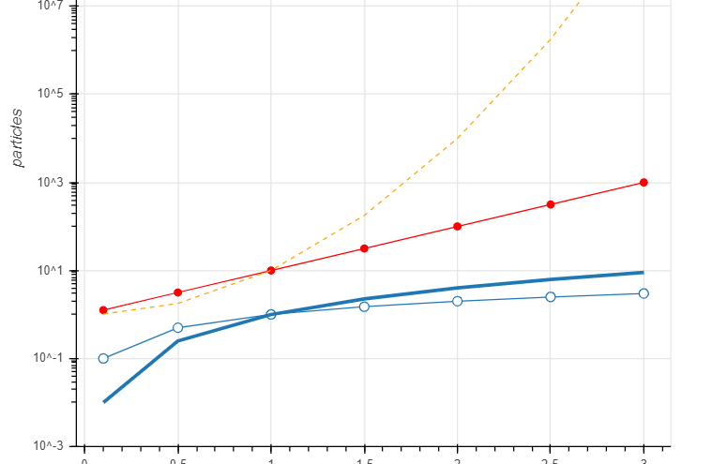
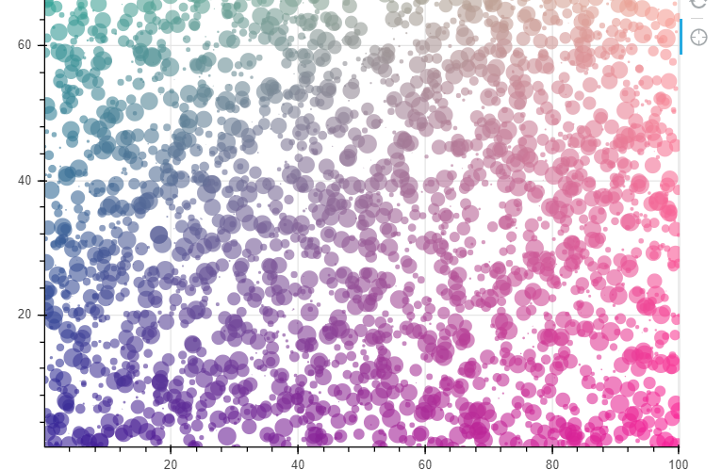
Bokeh charts
Bokeh is based on D3
Can be written in either Python or JS
Code written in Python can output HTML and Script or be injected into existing HTML
Do to technical difficulties with app deployment and data sources we eventually chose not to include a Bokeh chart.
These are for concept demonstration.

Slide 7
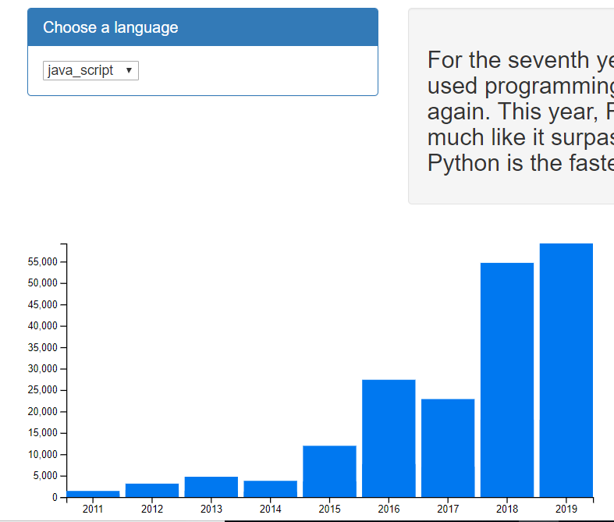
Programming Languages Preferences per year
Link to the app: https://lang-preferences.herokuapp.com/
Graphing yearly preference of individual programming languages
Highlight on mouseover
Language selection from dropdown

Slide 8
The story behind the Chart
What worked:
It loads!
Data loads on language selection.
Interactivity works.
What didn’t work:
Bug when updating.
Have to reload page if you change language a few times.

Slide 9
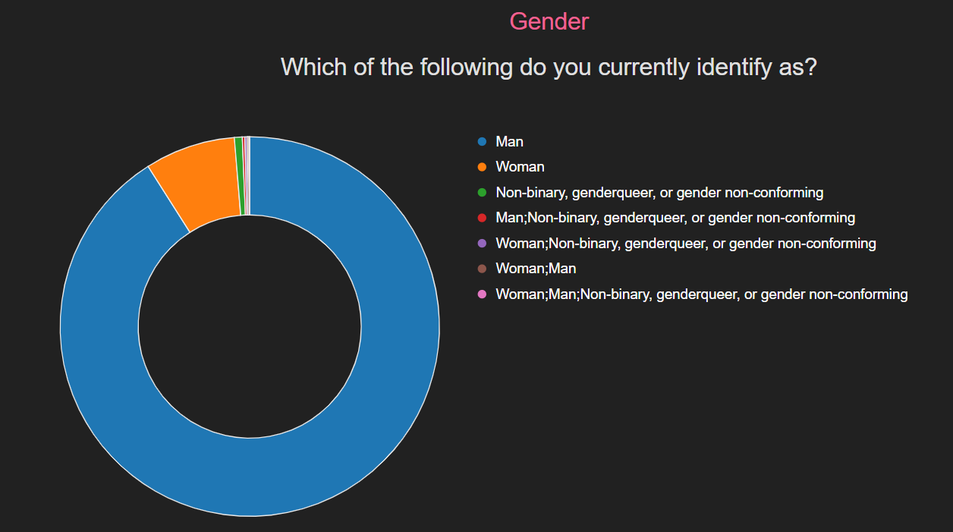
amCharts4: World Choropleth
Link to the app: https://js-overflow.herokuapp.com/
Visualizing multiple data relationships in multiple charts on one page.
Highlight and tooltip on mouseover.
Legend for each chart.

Slide 10
The story behind the Chart
What worked:
It loads!
Reads from DB for analytics.
What didn’t work:
One route is bugged, doesn’t work.

Slide 11
What would we do differently?
Migrate to one platform. (Heroku or Azure)
Integrate all visualizations into one site.
Fix the bugs!
More visualizations of data relationships.

Slide 12
Links to Github repos and app sites
Choropleth Heat Map
Programming Languages Bar Chart
D3 Donught Chart
Repos:
https://github.com/CyEdmonds/JS_Project_Sub.git
https://github.com/harishbk77/jsoverload_final.git
https://github.com/bellissima0419/js_overload.git
https://github.com/franklingonzales/Project_3_Developer_Survey_2019.git

Slide 13
Fin!
Thank you!

